Slide 1

Megacities
A snap-shot of urban development

Slide 2

Definition:
A megacity has two quantitative characteristics:
More than 2,000 people per square mile
More than 1,000,000 people within city limits

Slide 3






Our cities: the top 5
1
2
3
New York
Los Angeles
Chicago
4
5
Houston
Phoenix

Slide 4

Measures
Economic
Median Household Income, Unemployment Rate, Cost of Living, Poverty
Demographic
Population Density, Median Age, Education Level
Housing
Median Home price, Rental Price (Median Rent), Homeownership Rate
Quality of Life
Crime Rate, Air Quality Index, Commute time, Walkability Score

Slide 5
Research Questions
Which cities have higher population density?
If a city is larger, will there be higher household income and higher unemployment rate?
If a city is larger, will it have a higher median age and education level?
How does city size relate to poverty rates and median rent?

Slide 6

Data Visualization

Slide 7
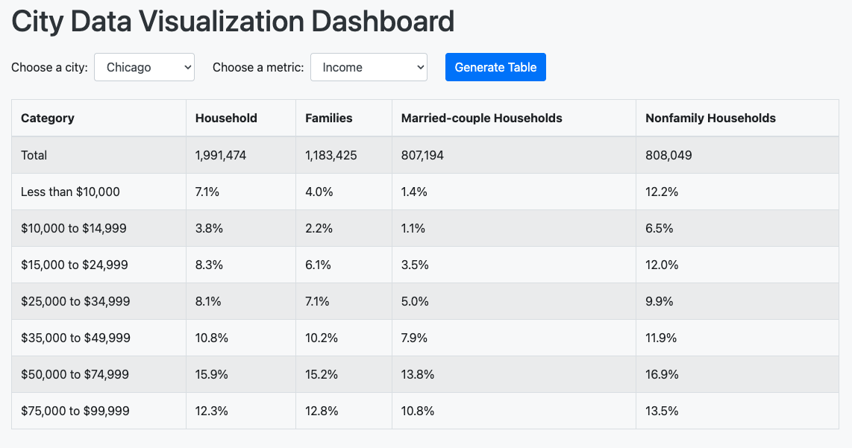
Interactive Data Visualization Dashboard

Slide 8
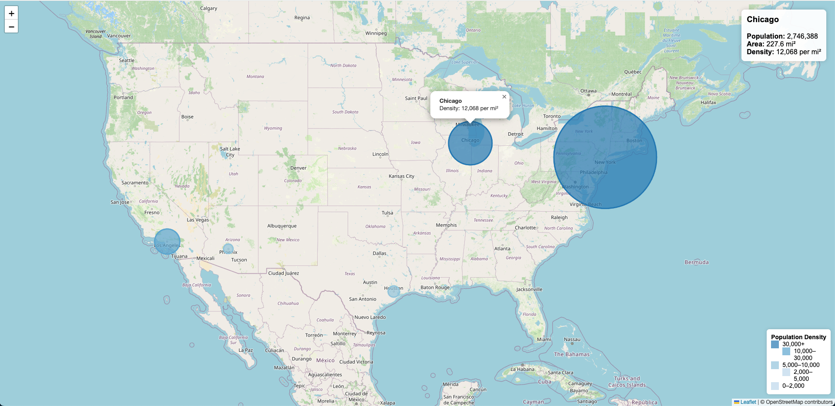
Visualization #1 – interactive population density map

Slide 9
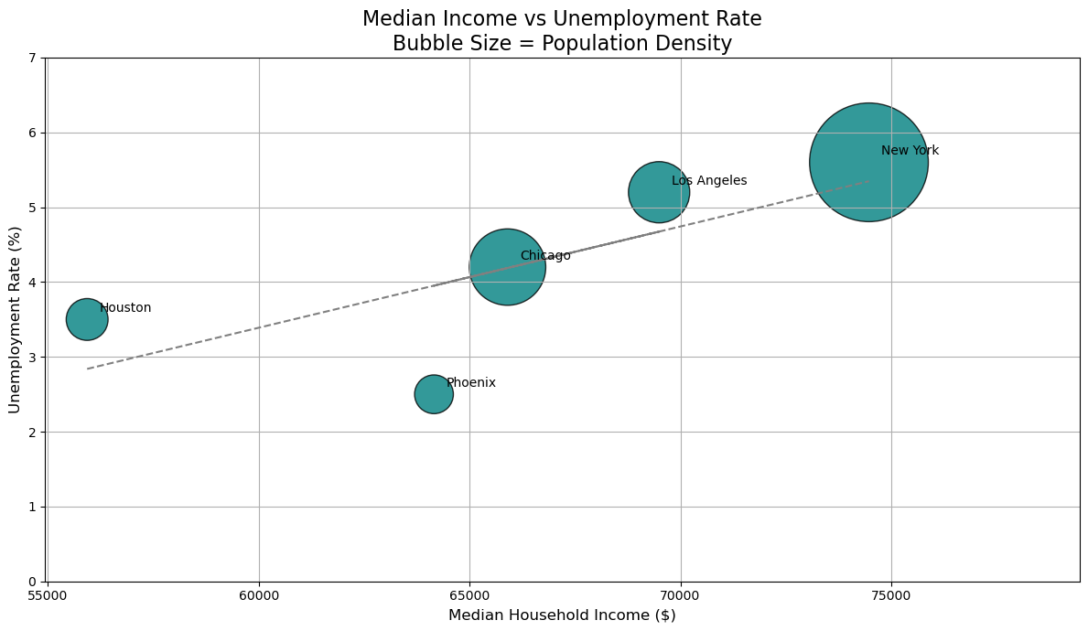
Visualization #2 – income/unemployment scatter plot

Slide 10
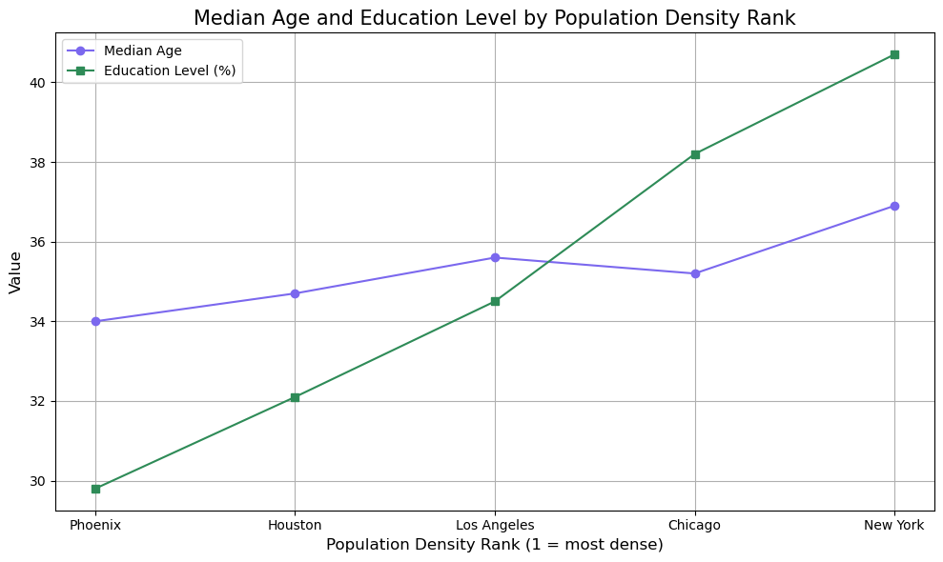
Visualization #3 – Age/Education double line graph

Slide 11
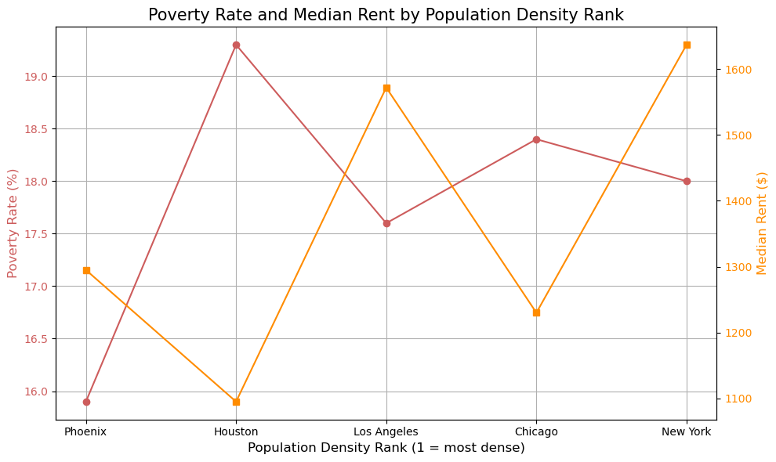
Visualization #4 – poverty/rent double line graph

